Slide 1


BOLT Thunderstorm Tracking
Zen KAWASAKI
Professor Emeritus at Osaka University
RAIRAN Pte. Ltd.

Slide 2
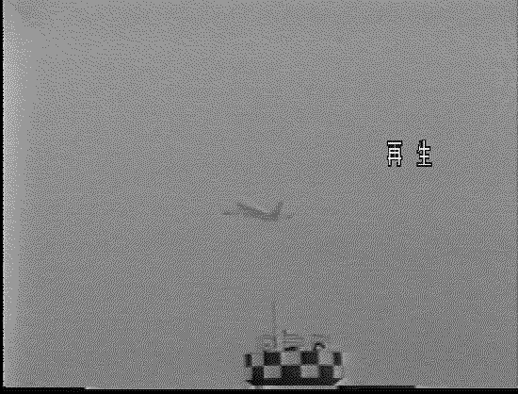
Lightning triggered by an airplane (movie)

Slide 3
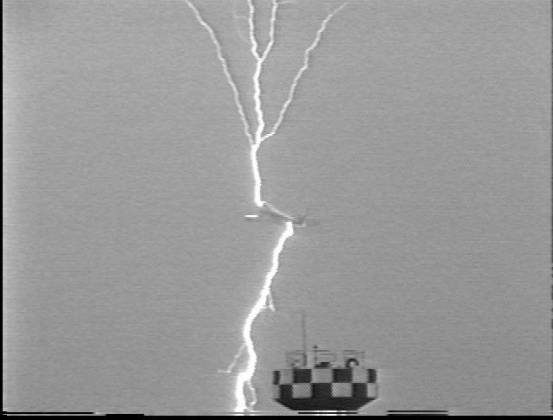
Lightning triggered by an airplane (frame by frame)
１.
２.
３.
４.
５.
６.
７.
８.
９.
An evidence of a bi-directional leader initiation

Slide 4
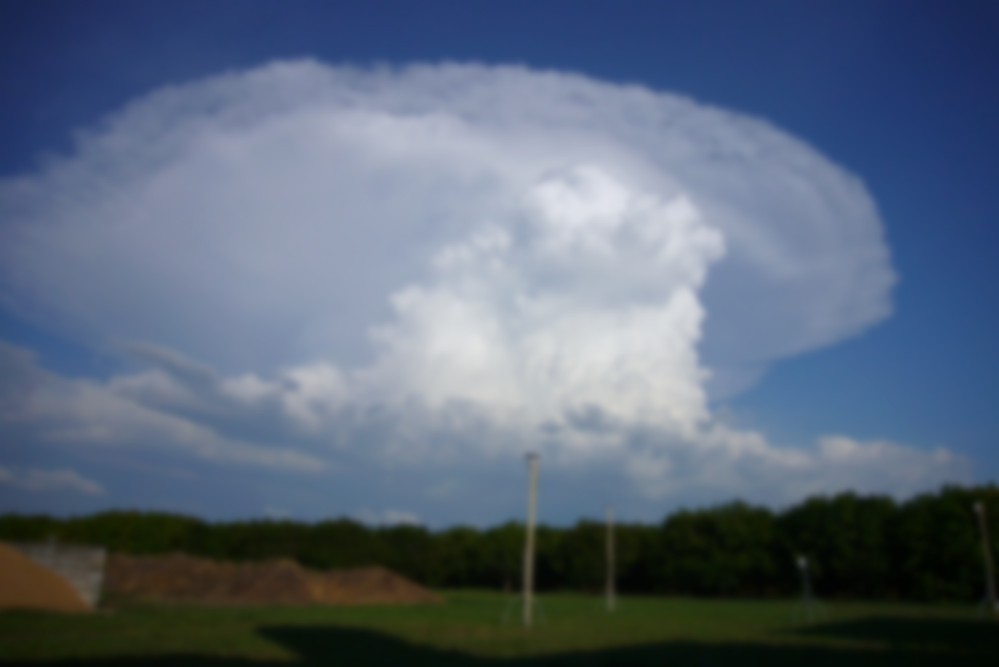
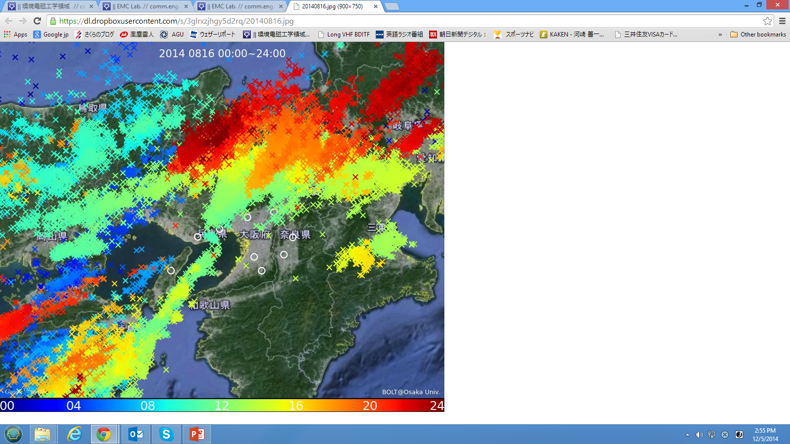
BOLT deployment diagram
Local Stations
Main Stations
Site 1
LF Antenna
Including Amp.
GPS
Internet or Mobile
(Per site)
Server
BOLT remote station
Analyzer
Display
Site N
LF Antenna
Including Amp.
GPS
Internet Distribution
BOLT remote station
This layout can be applicable for any ‘N’ Sites.
(‘N’ = No. of sites)

Slide 5
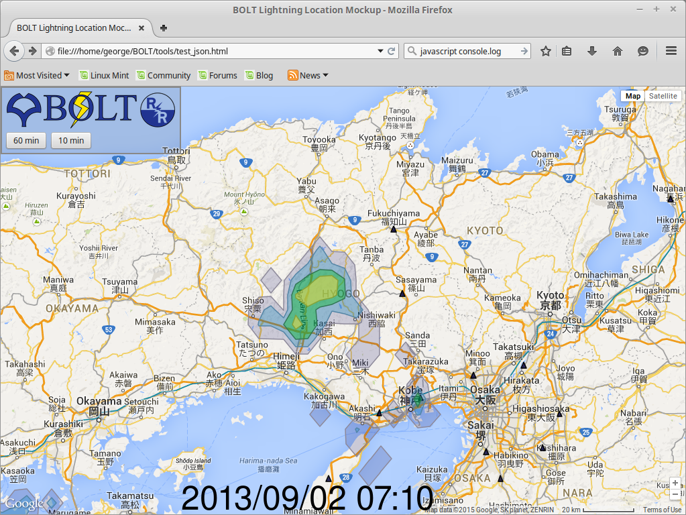


Slide 6


Slide 7
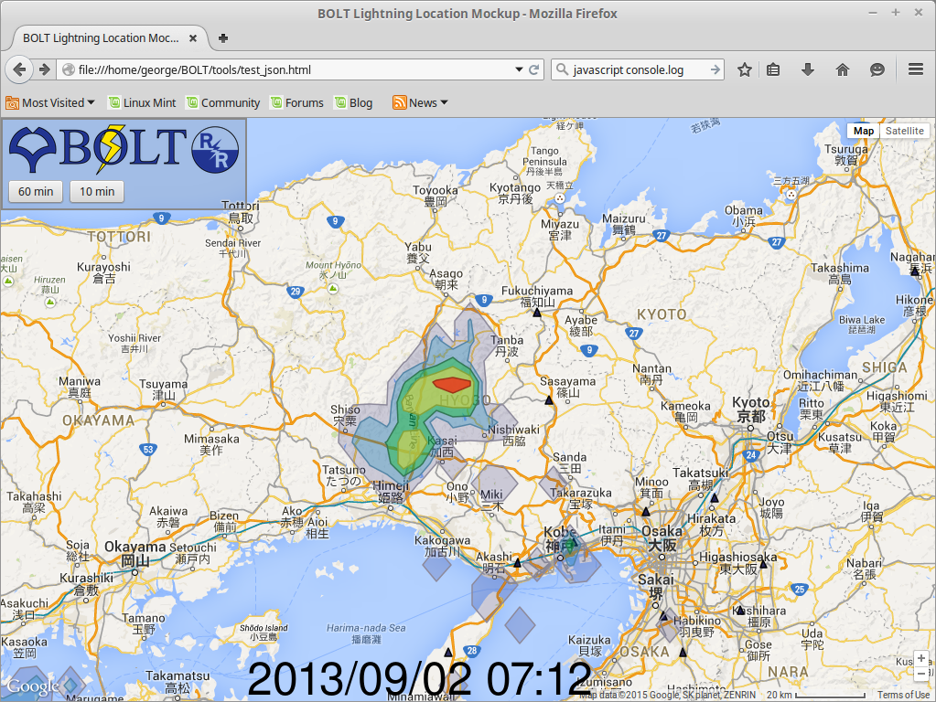

Slide 8
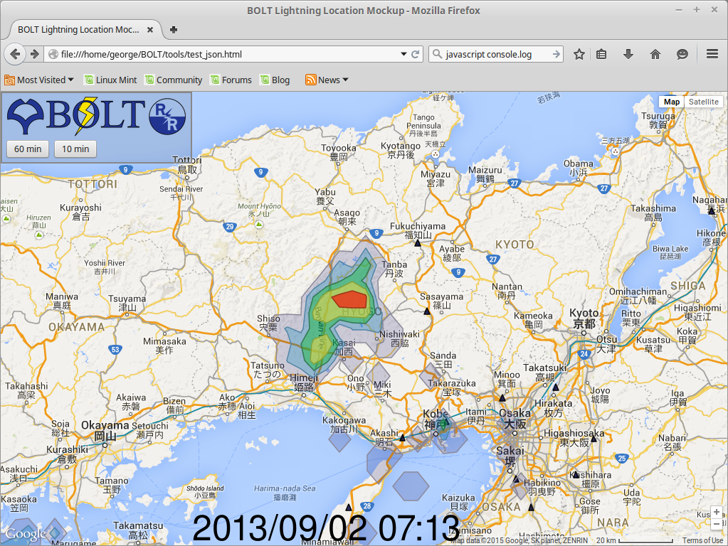

Slide 9
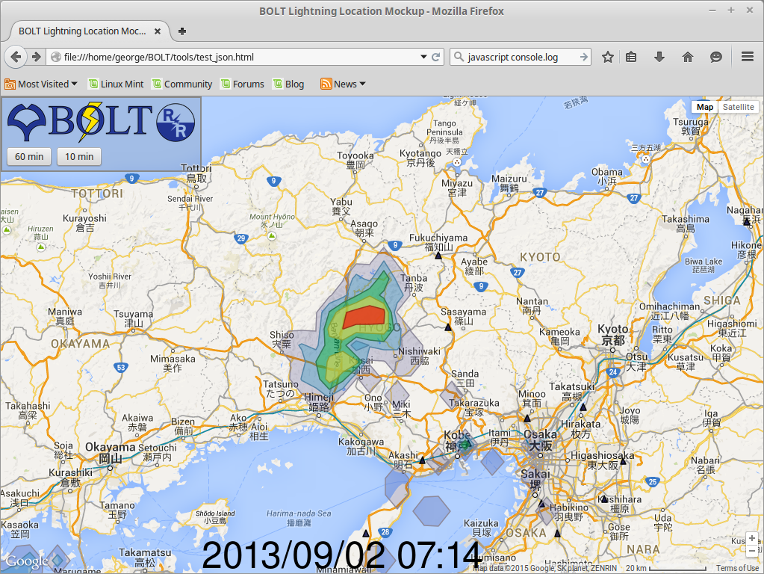

Slide 10


Slide 11


Slide 12
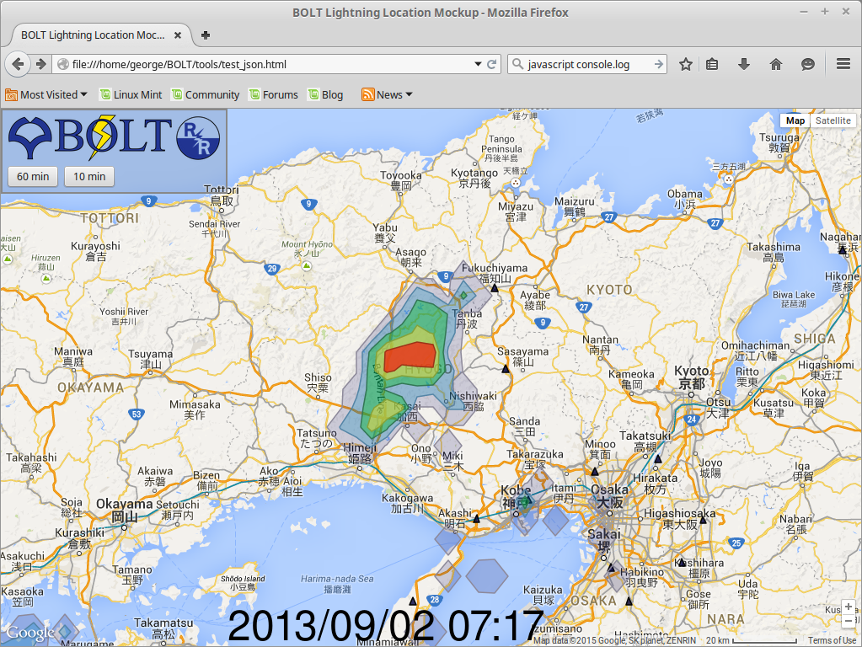

Slide 13
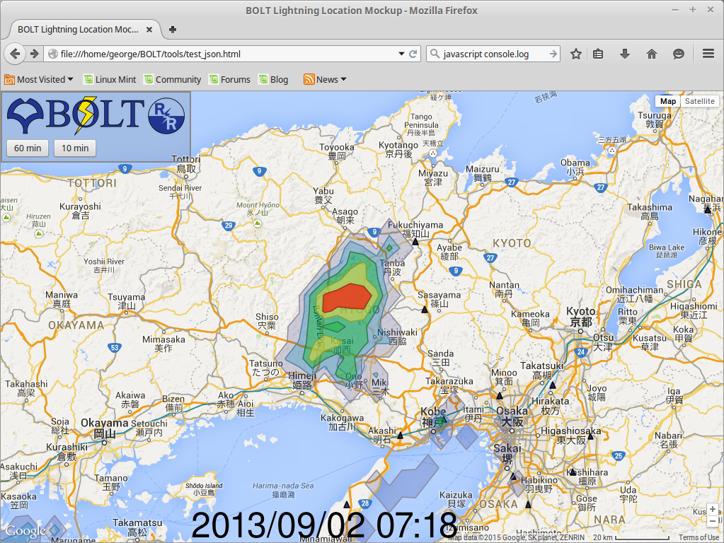

Slide 14
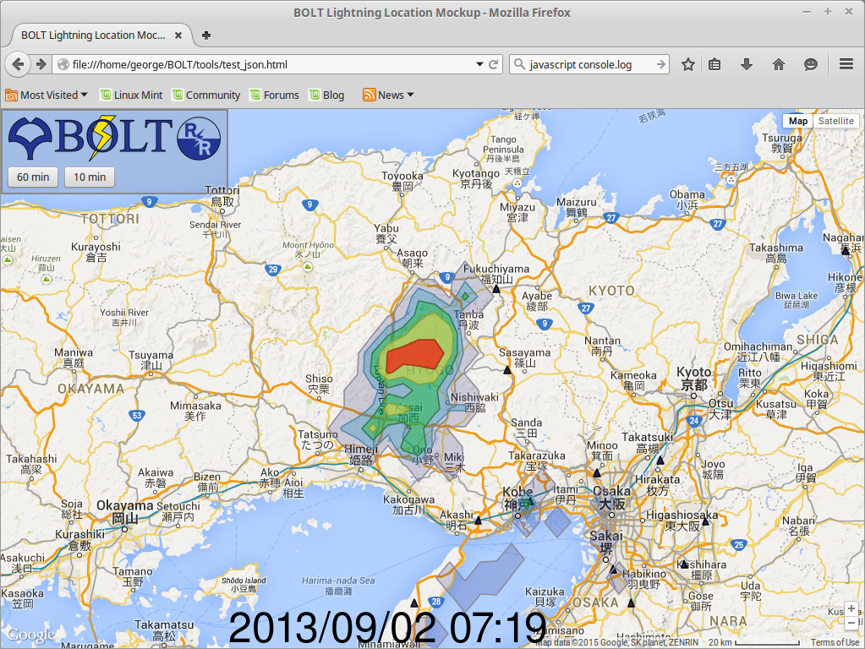

Slide 15


Slide 16
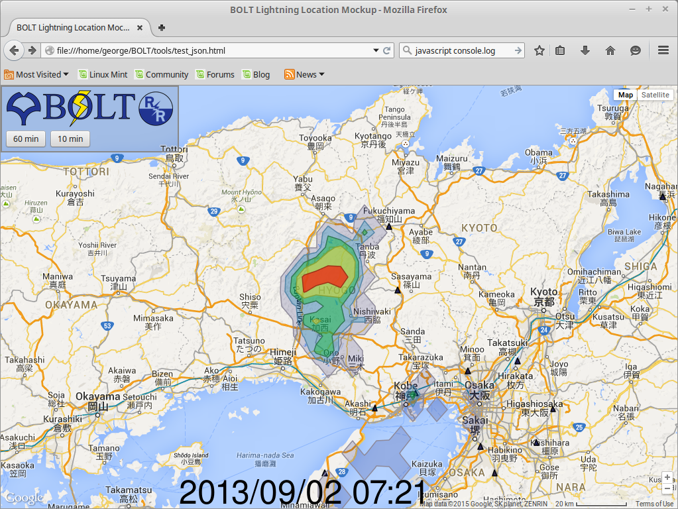

Slide 17


Slide 18
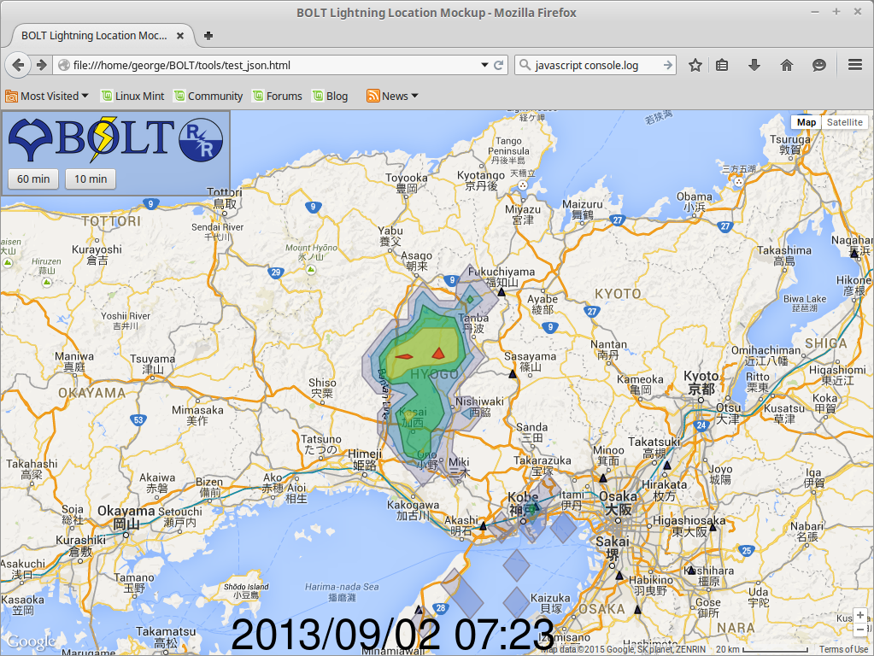

Slide 19
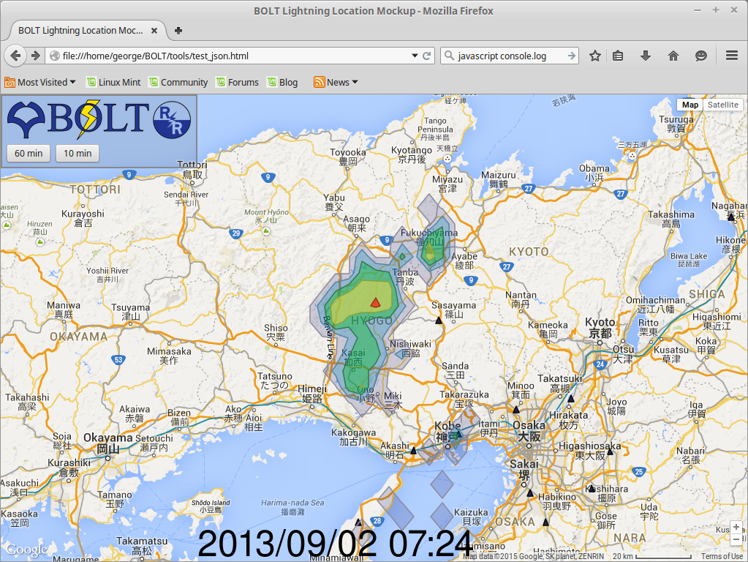

Slide 20
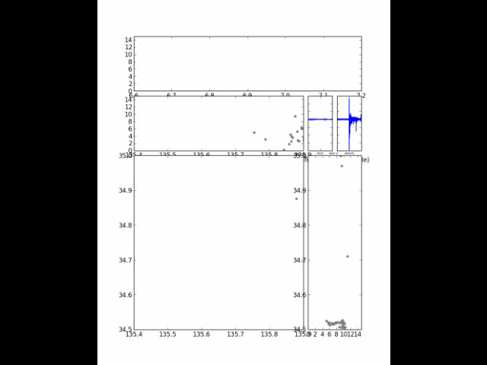
Real time 3D monitoring is possible.
Height as a function of time
Height VS East-west cross section
Projection on the ground
Height VS North-
south cross section

Slide 21
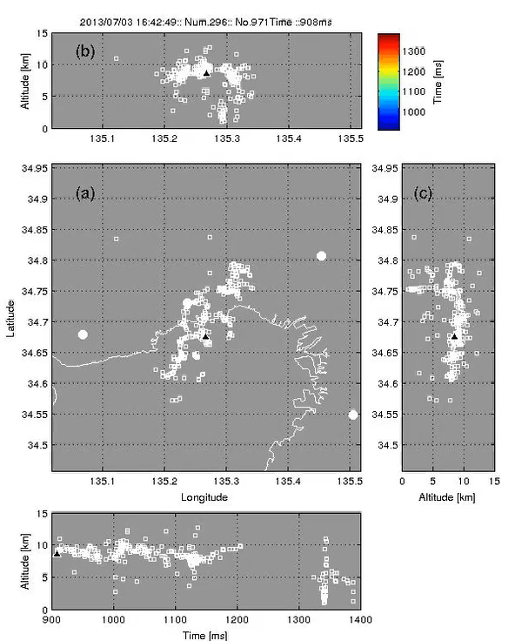
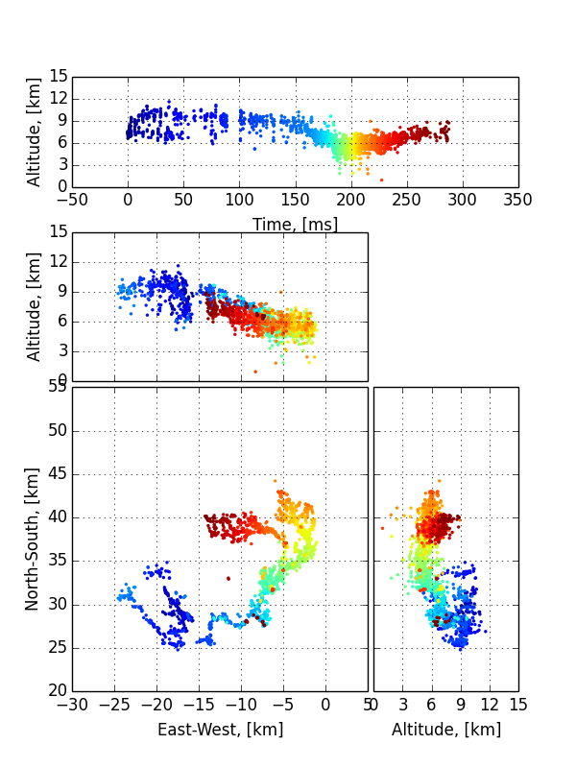
An example of BOLT 3D observation
The top panel is the altitude of BOLT location as a function of time.
The second panel is the west to east cross section. The ordinate is the height.
The bottom right panel is the north to south cross section, and abscissa is the height of BOLT location
The bottom left is the BOLT location projected on the
A color time code is applied, cool color to warm one

Slide 22
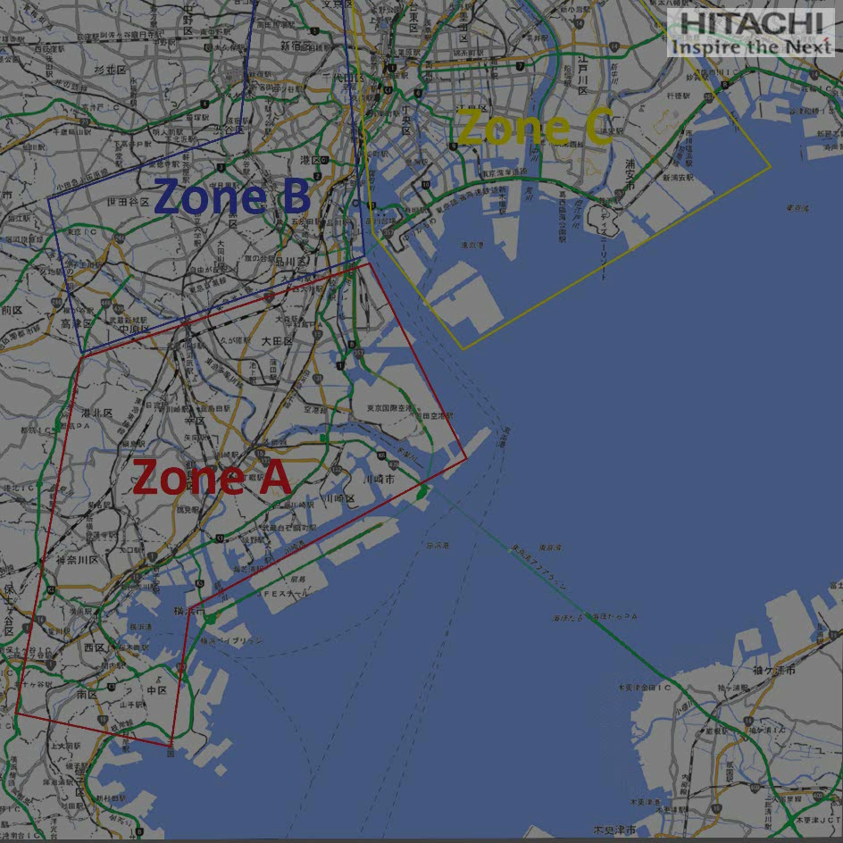

Slide 23
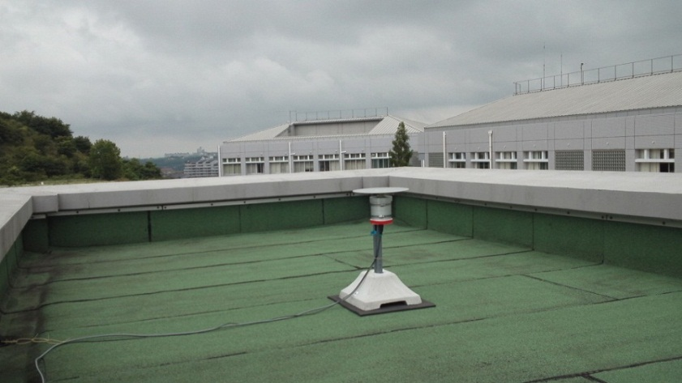
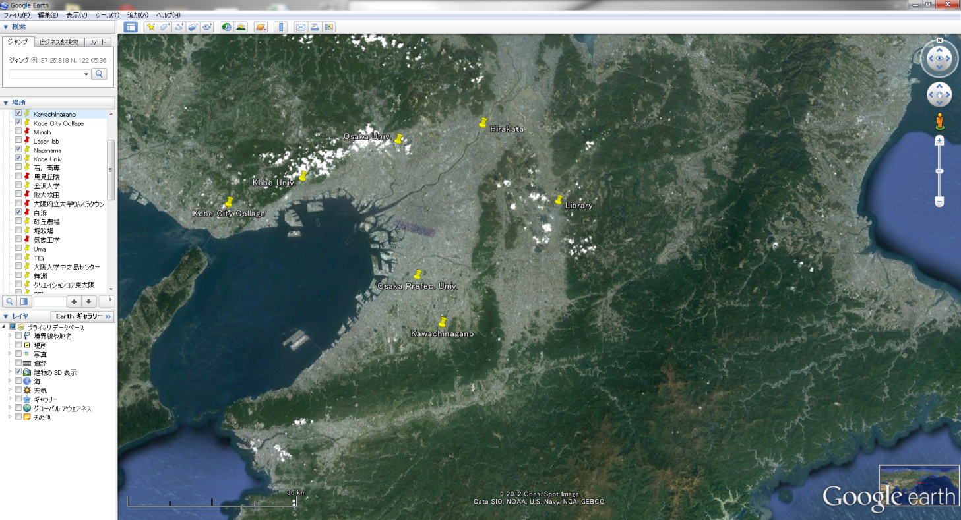
BOLT existing configuration and specifications in Osaka, Japan
BOLT antenna
20 km
Antenna array
Antenna sites
50km
Specifications
Pass band | ～500kHz
Sampling rate | 4MHz
Amplitude Resolution | 16 bit
Time resolution | 1 ms
Time constant | 200 μs

Slide 24
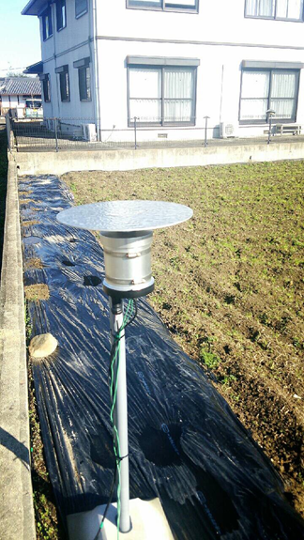
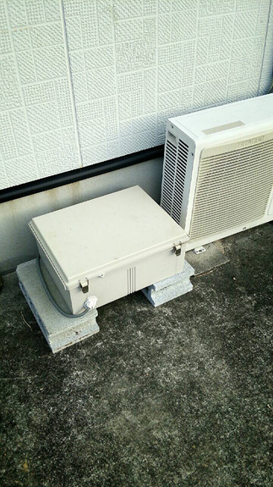
BOLT antenna
BOLT local station
Easy installation! Both are able to be deployed on the ground and on the roof.

Slide 25
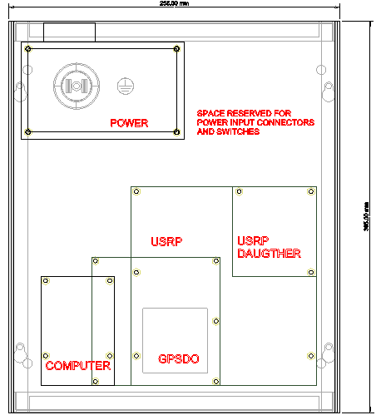
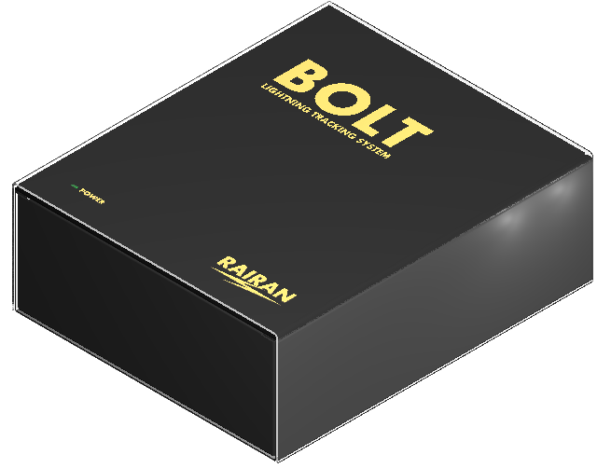
BOLT improved looks for Local Control Box
Total power consumption: 50Watts
Operating voltage: 100volts -240volts
Preferable temperature range: -20 to +50 degrees
Ventilation is equipped with 2 watts fan.
Water proof is guaranteed.

Slide 26
Electromagnetic wave remote sensing
Classical VLF/LF(Existing System)
Radiation from strokes
One LF pulse per stroke
Low spatial and time resolution
Like still picture
Our VLF/LF BOLT
Radiation from discharge development
One thousand pulses for LF
High spatial and time resolution
Like movie picture
One location/1stroke
×
×
×
×
×
×
×
×
×
×
×
×
×
×
×
×
×
×
×
×
×
×
×
×
×
×
×
×
×
×
×
×
×
×
×
×
×
×
×
×
×
×
×
×
×
×
×
×
×
×
×
×
×
×
×
×
×
×
×
×
×
×
×
×
×
×
×
×
×
×
×
×
×
×
×
×
×
×
×
×
×
×
×
×
×
×
×
×
×
×
×
×
×
×
×
×
×
×
×
×
×
×
×
×
×
×
×
×
×
×
×
×
×
×
×
×
×
×
×
×
×
×
×
× One thousand locations/1flash

Slide 27
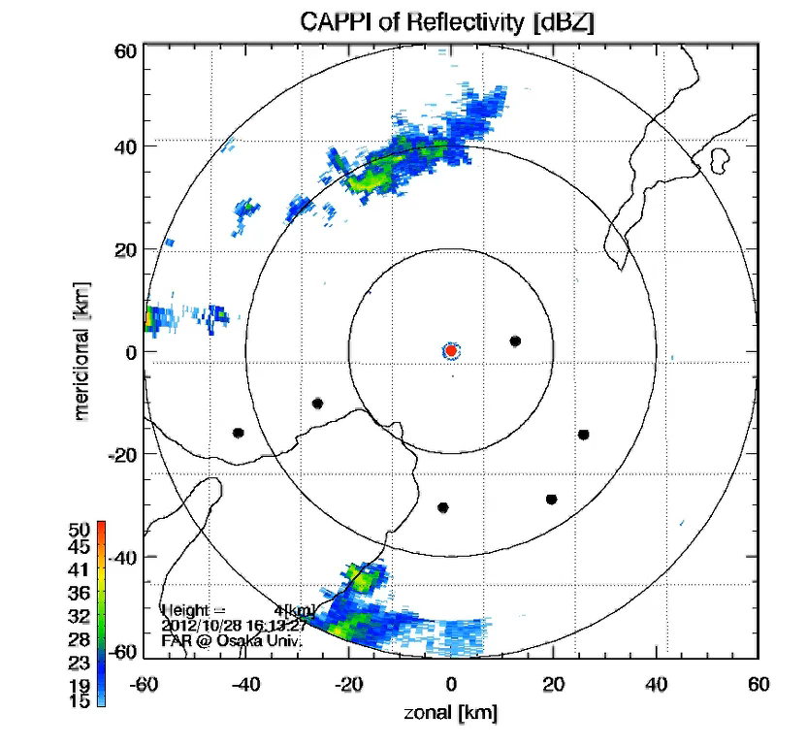
BOLT locations overlay on the RADAR echo (CAPPI).
Squares are the positions of BOLT location.
Radiuses are 20km, 40km and 60km respectively.
A red dot is the position where we expect the warning.
The cloud system travels from west to east.
Warning : when clouds edge crosses to 20km!!
Warning at 5:37, and lightning strikes at 5:57.
We can issue a warning in 20 minutes in advance to evacuate. It is believed to be sufficient.
This is an evidence of prediction by BOLT.

Slide 28
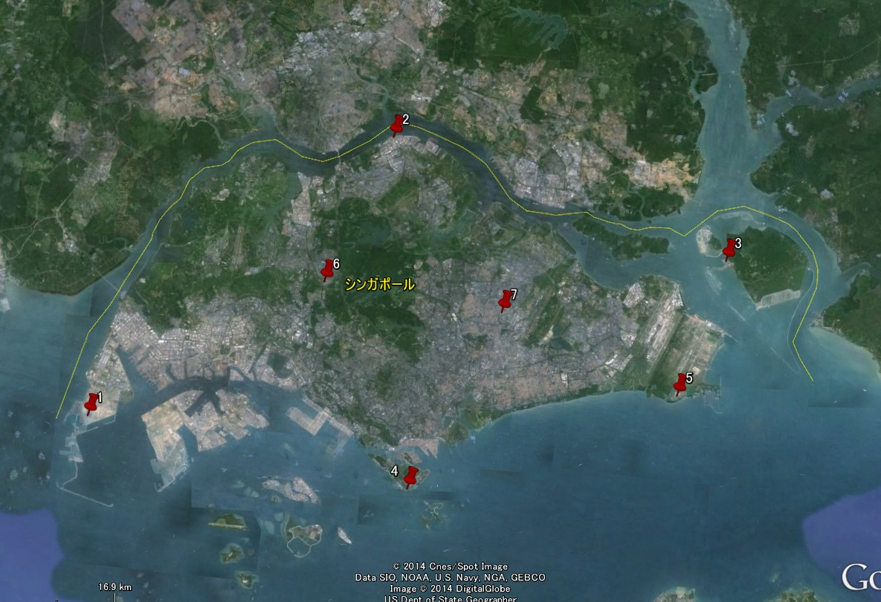
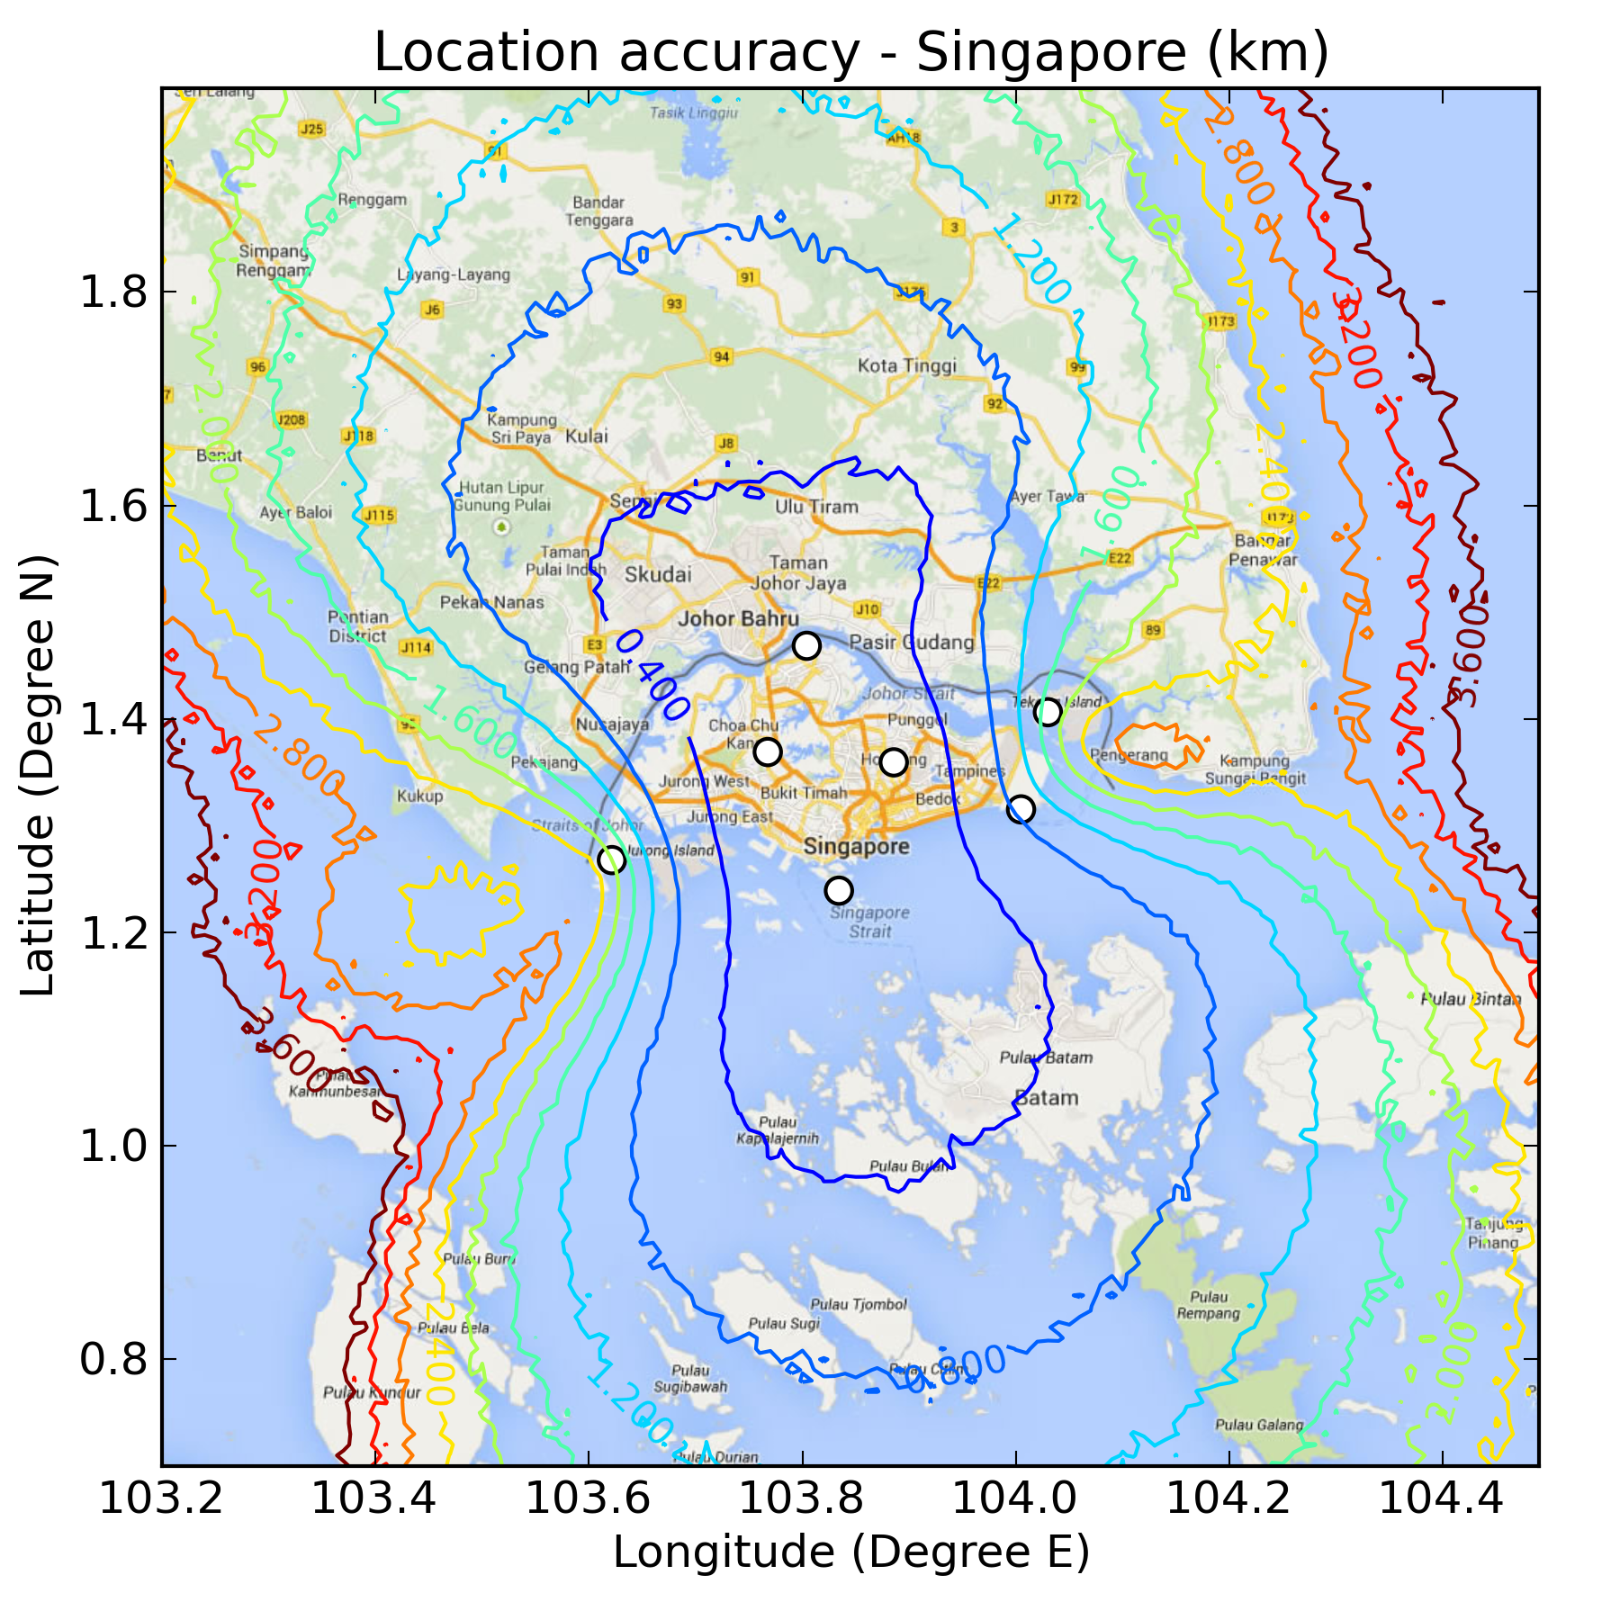
BOLT configuration in Singapore and location accuracy
Seven BOLT antennas are sufficient to cover whole Singapore.

Slide 29
Principle and feature of BOLT
LF electromagnetic pulse associated with electrical activity
Maximum one thousand location for one second in real time
In case of optional function, 3D is given by thousands location
A passive RADAR with higher time resolution than conventional one
Total electrical activity in severe storms is imaged.
Heavy precipitation and lightning strike can be forecasted in 10 minutes advance.

Slide 30
The tentative goal of RAIRAN
Solution Business for Natural Disaster Prevention
Sales activity for remote sensing technology and information
Monitor center in Singapore of rain, thunderstorm and Tsunami
Collaboration with Weather Matrix Pte. Ltd.
Technical transfer of innovation to the South-East Asia
Technical transfer to support ASEAN country
Education and digging out possible solution business
Further understanding of Global warming through observations

Slide 31
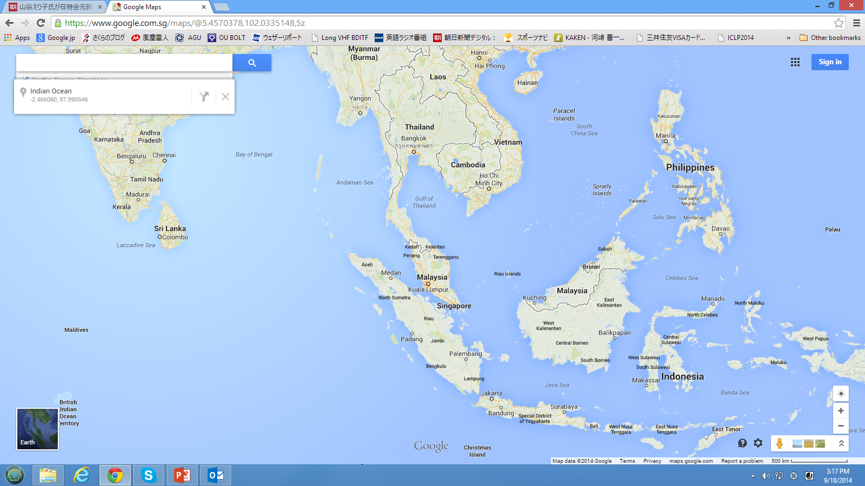
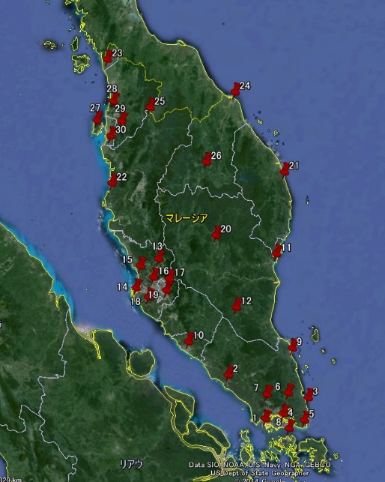
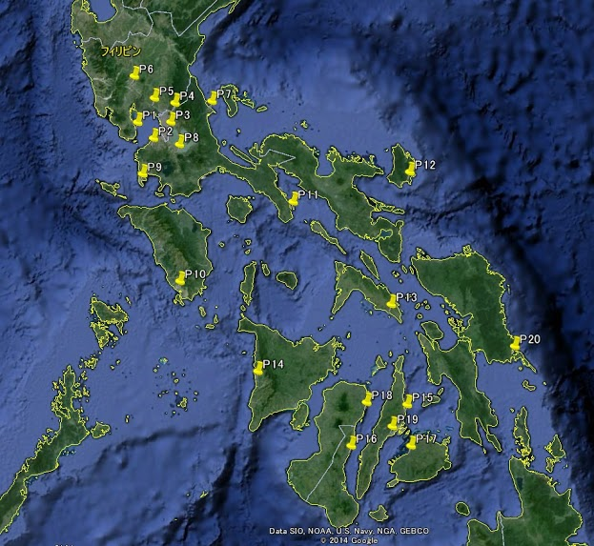
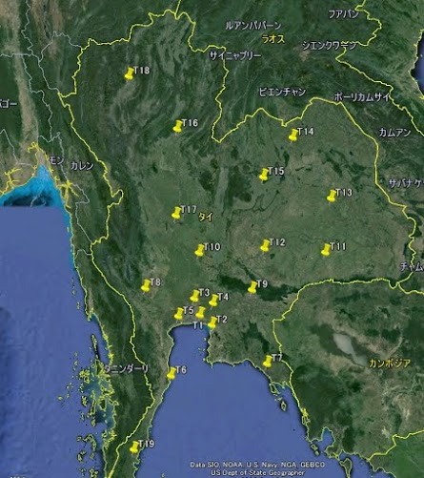
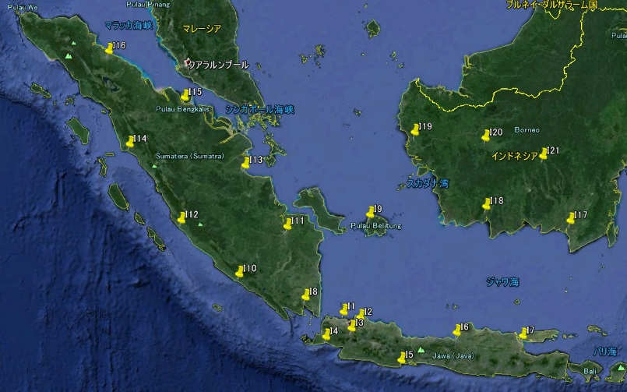
The final goal is the BOLT operation whole over South-East Asia
BOLT observations are equivalent to thunderstorm observations from the aspect of precipitations.

Slide 32
GOAL:
Operation of BOLT
over the South East Asia
Start from some local and
expand the coverage gradually!

